Slide 1



Data analysis project
CROWD FUNDING
Data analysis using Excel, SQL, Power BI& Tableau

Slide 2



TEAMMATES
Harshitha reddy
Pranitha
Vishwaraj
Raj bheda

Slide 3

INTRODUCTION
Crowd funding
Project objectives
Crowdfunding is a method of raising money from a large number of people through online platforms. Many startups and creative projects use crowdfunding to collect funds.
In this project, we analyzed crowdfunding data to understand:
Which projects are successful
Which categories attract more funding
Which locations have more projects
Patterns behind successful and failed projects
Tools used in this project include SQL, Excel, Power BI, and Tableau for data cleaning, analysis, and visualization.
The main objectives of this project are:
To analyze crowdfunding project data
To identify successful vs failed projects
To understand project distribution by category and location
To create dashboards and charts for better visualization
To provide insights and recommendations for improving project success rate

Slide 4


PROJECT REQUIREMENTS
The following requirements were needed to complete the project:
Crowdfunding dataset containing project information
Tools for data analysis and visualization
Data cleaning and preprocessing
Dashboard creation
Software Used:
SQL – Data extraction and querying
Excel – Data cleaning and KPI analysis
Tableau – Data visualization dashboards
Power BI – Interactive data dashboards

Slide 5

DATASET DESCRIPTION
The dataset used in this project contains information about different crowdfunding campaigns. It includes details about projects, creators, categories, and locations.
Key fields in the dataset include:
1)Project ID – Unique identifier for each project
2)Category ID & Category Name – Type of project category
3)Creator ID – Information about the project creator
4)Location ID & Location Name – Location where the project was created
5)State – Status of the project such as successful or failed
This dataset helps analyze crowdfunding trends and understand which types of projects are more successful.

Slide 6
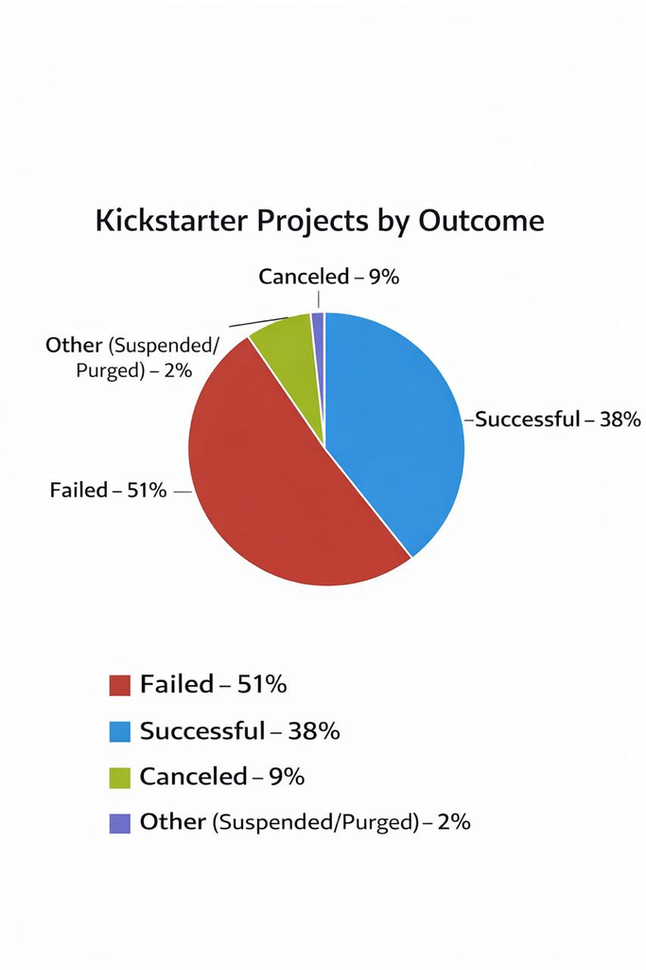
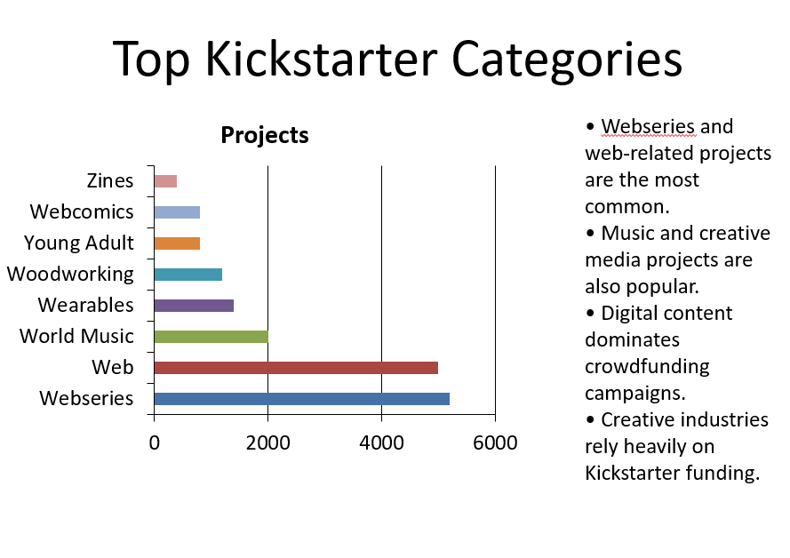

CHARTS

Slide 7
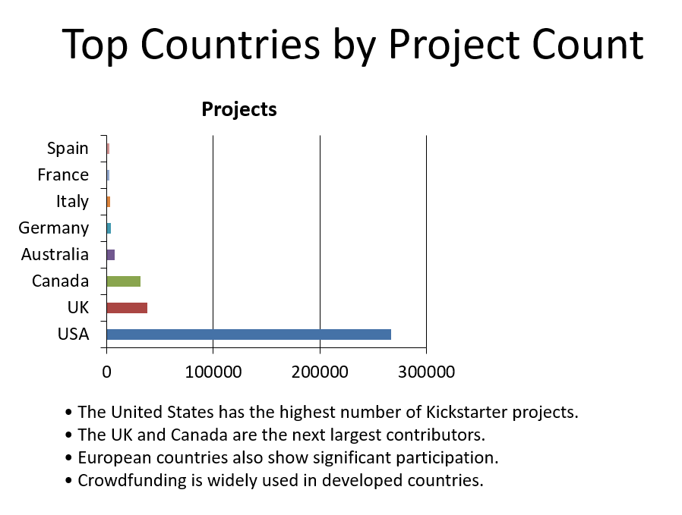
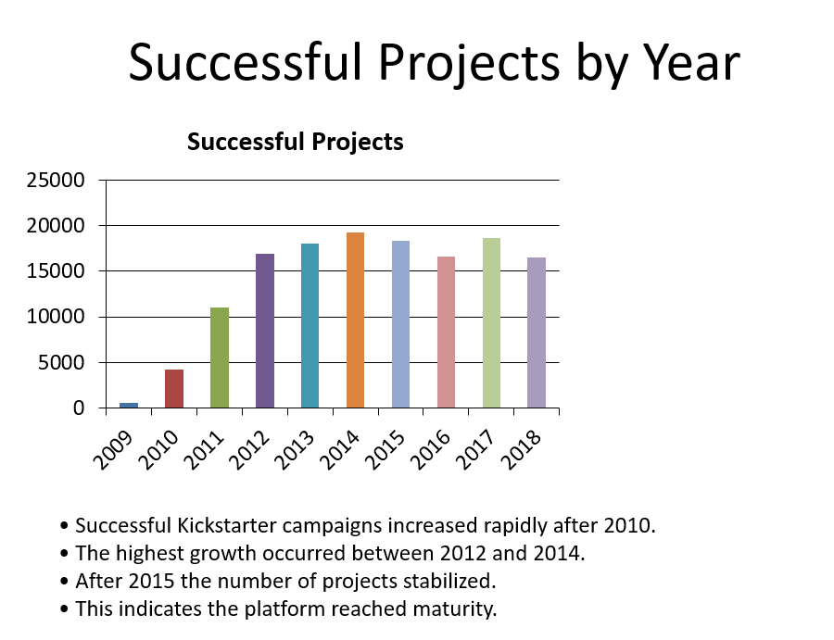
CHARTS

Slide 8

DASHBOARDS

Slide 9

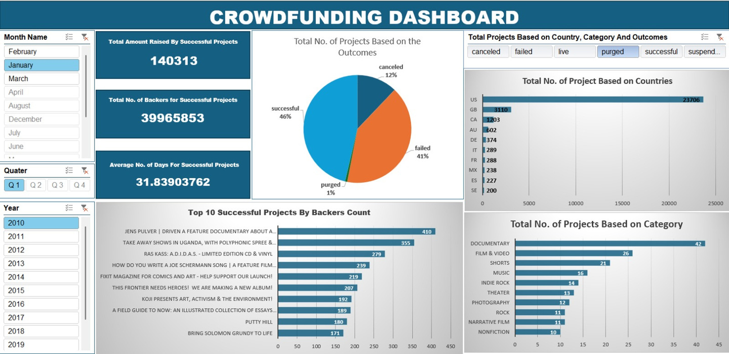
EXCEL DASHBOARD
In Excel we created:
KPI metrics
Project counts
Data summary tables
Pivot charts
Excel helped in data cleaning and quick analysis before building dashboards in other tools.
The dashboard includes:
Total number of projects created in the dataset
Successful vs Failed projects analysis
Projects by category to identify popular project types
Projects by location to understand geographical distribution

Slide 10

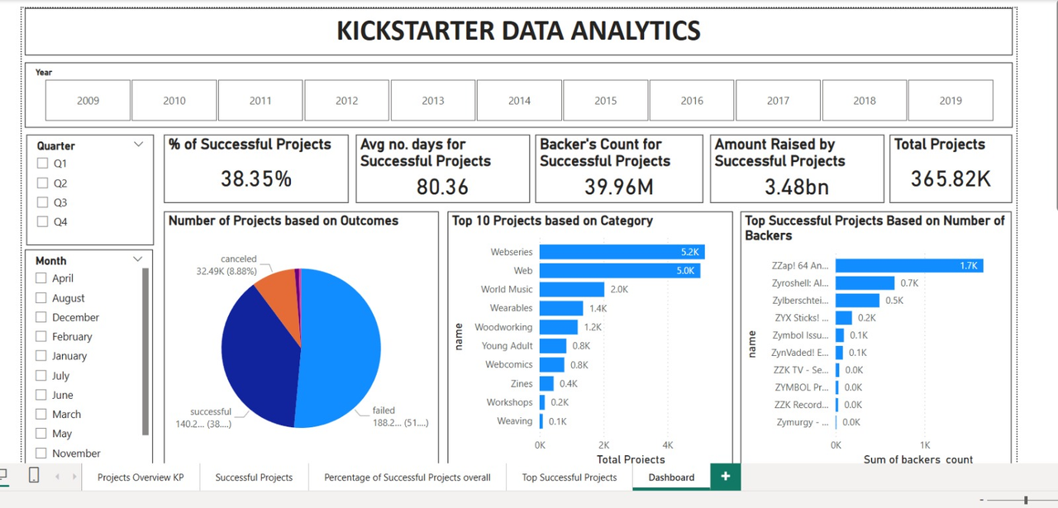
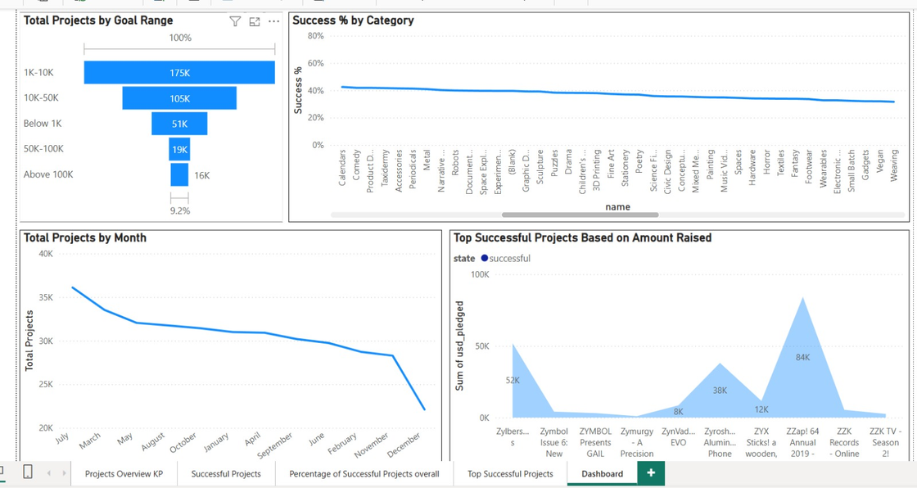
POWER BI DASHBOARD
Power BI was used to create advanced dashboards with:
Data relationships
Visual analytics
Interactive filters
Power BI provides a clear and interactive view of project data.
In this dashboard we analyzed:
Successful vs Failed Projects to understand project performance
Projects by Category to identify the most popular categories
Projects by Location/Country to see where most projects are created
Creator activity to understand how many projects are created by different creators

Slide 11

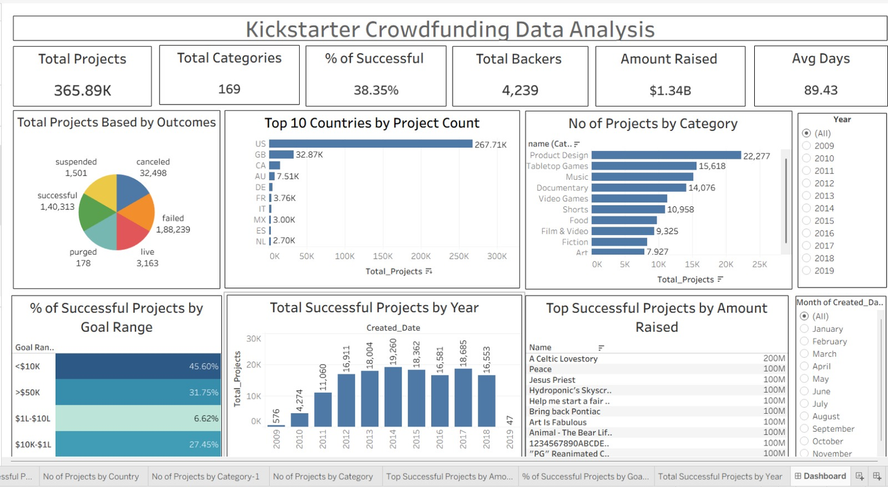
TABLEAU DASHBOARD
Tableau was used to create interactive visualizations such as:
Success vs Failed Projects Pie Chart
Projects by Location
Projects by Category
Creator activity
This dashboard helps users explore project data visually.
In this dashboard we analyzed:
Successful vs Failed Projects to understand project performance
Projects by Category to identify the most popular categories
Projects by Location/Country to see where most projects are created
Creator activity to understand how many projects are created by different creators

Slide 12
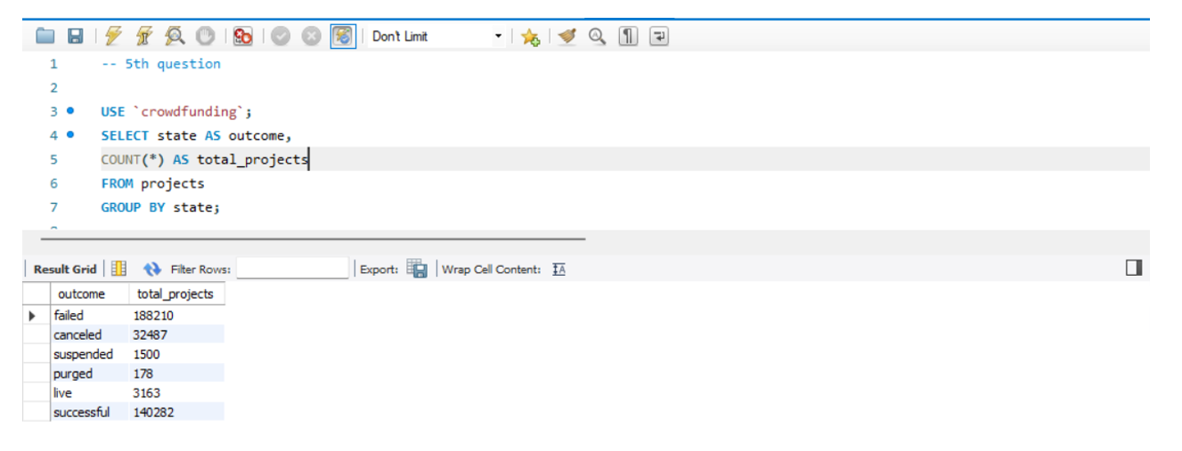
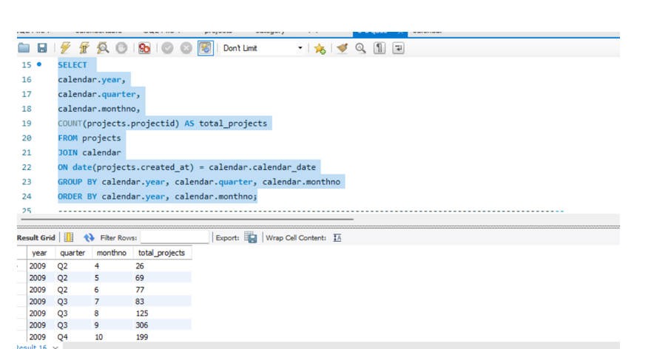
SQL QUERIES
Crowd Funding Project Outcomes
This query analyzes the outcomes of crowdfunding projects.
It groups the projects based on their state or status.
Outcomes include states such as successful, failed, canceled, suspended, and live.
Project Timeline Analysis
This query extracts the calendar year, quarter, and month from the dataset.
It helps organize crowdfunding project data based on time periods.
This makes it easier to analyze trends across different months and years.
It is useful for identifying seasonal or yearly patterns in crowdfunding campaigns

Slide 13
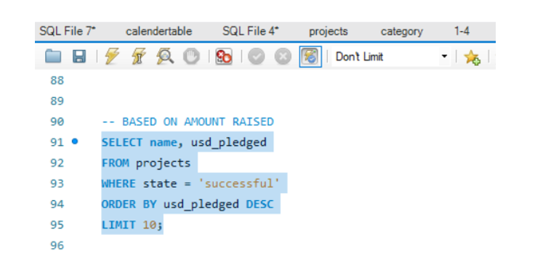
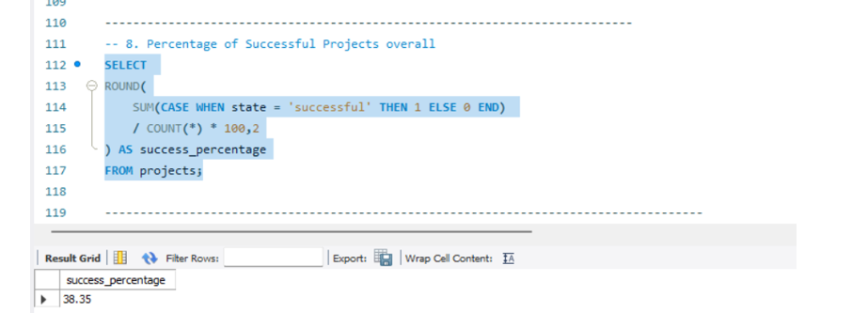
SQL QUERIES
Total Amount Raised By Projects
This query calculates the total amount of money raised by crowdfunding projects.
It helps to understand how much funding was collected from supporters.
The result shows the overall financial performance of the campaigns.
Percentage Of Successful Projects
This query calculates the overall percentage of successful crowdfunding projects.
It compares the number of successful projects with the total number of projects.
The result helps to measure the success rate of campaigns.

Slide 14
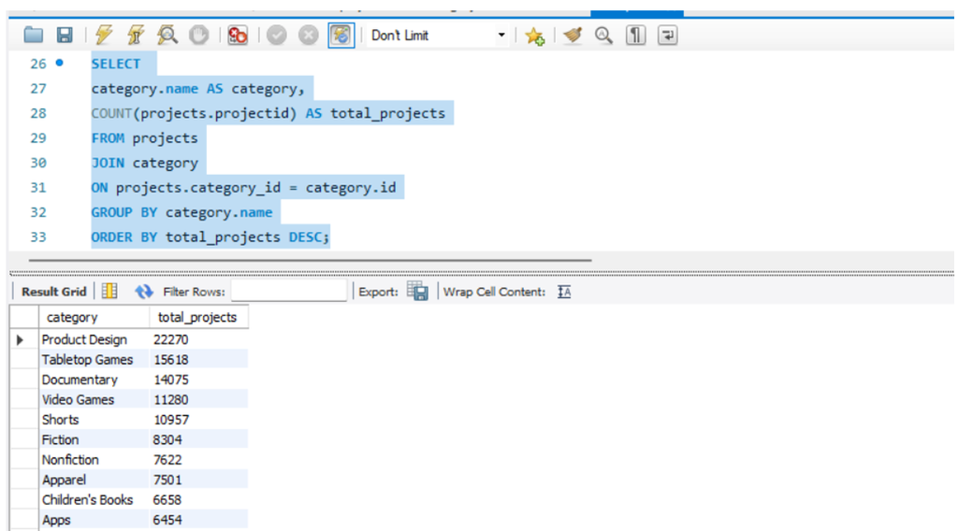
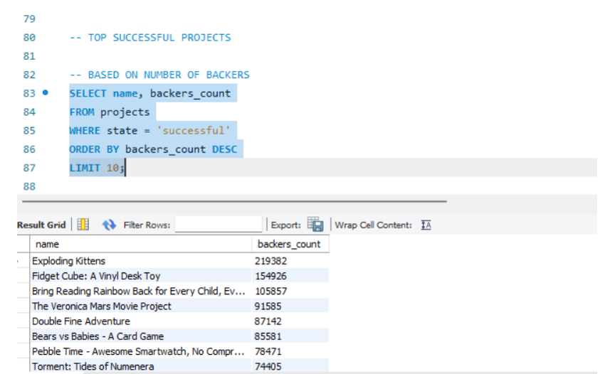
SQL QUERIES
Projects By Category
This query shows the number of crowdfunding projects in each category.
It groups projects based on their category names.
This helps identify which categories have the most campaigns.
The result highlights popular categories among creators.
Top 10 successful Projects By Backers
This query identifies the top 10 successful crowdfunding projects based on the number of backers.
It selects projects where the state is marked as successful.
The projects are ordered by backers_count in descending order.

Slide 15
CONCLUSION
The analysis of crowdfunding data provides valuable insights into project performance and trends.
It shows how project outcomes, categories, funding goals, and locations influence campaign success.
Successful projects often attract more backers and set realistic funding goals.
Overall, this analysis helps understand key factors that lead to successful crowdfunding campaigns.
RECOMMENDATION
Creators should set realistic funding goals to increase the chances of project success.
Choosing popular and high-demand categories can help attract more backers.
Promoting campaigns effectively can improve visibility and supporter engagement.
Focusing on countries with strong crowdfunding activity may increase project reach.
Using data analysis can help creators plan better and improve campaign performance.

Slide 16

THANK YOU

